Slide 1
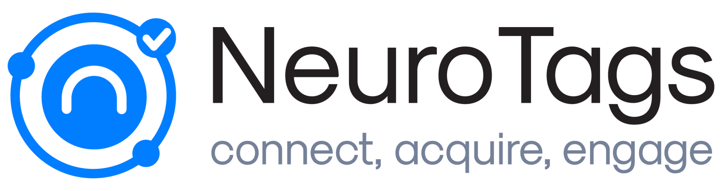
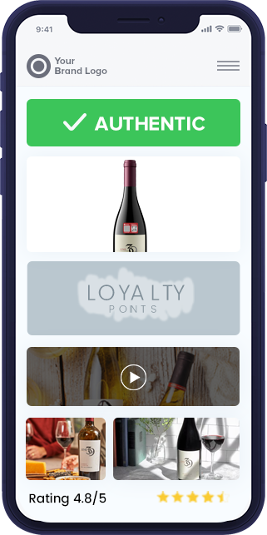
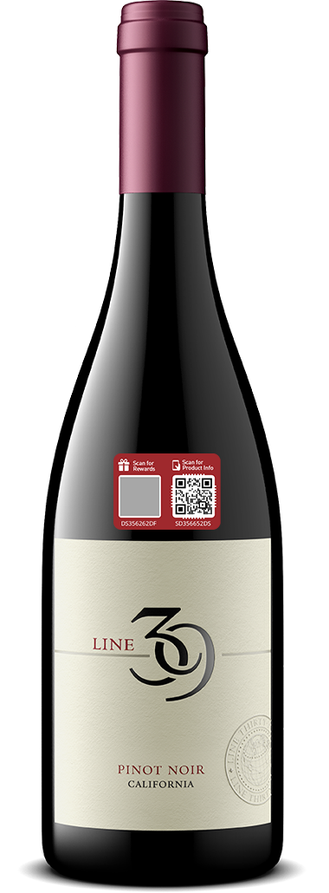
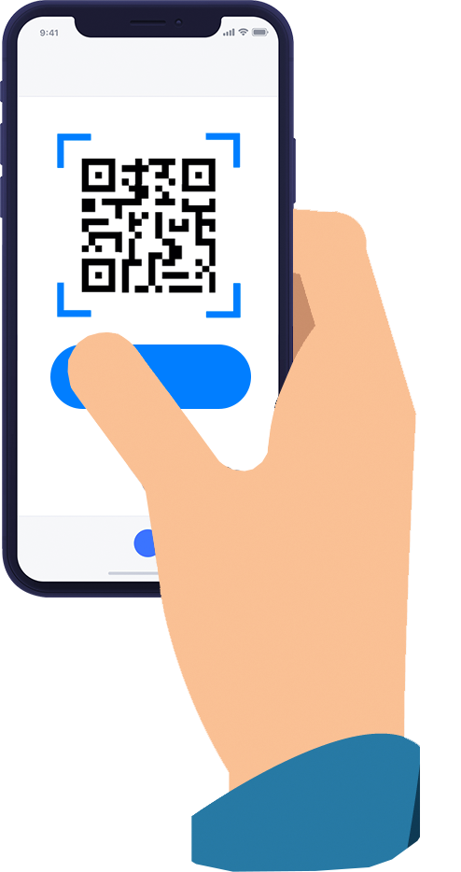

Use your product to
protect, engage and drive sales
harvey@neurotags.com
Notes:
Can we make the graphics more appropriate

Slide 2
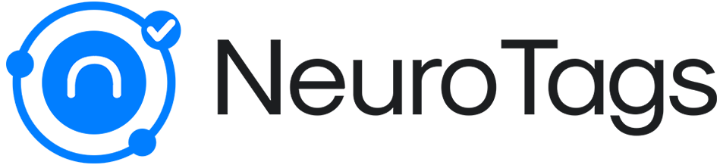


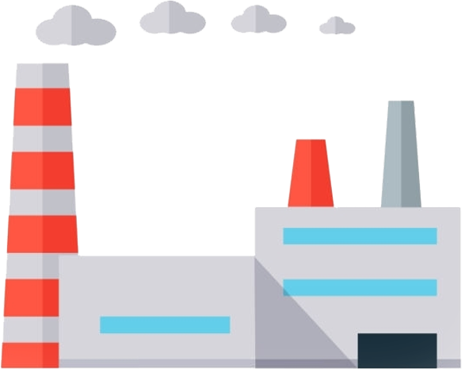
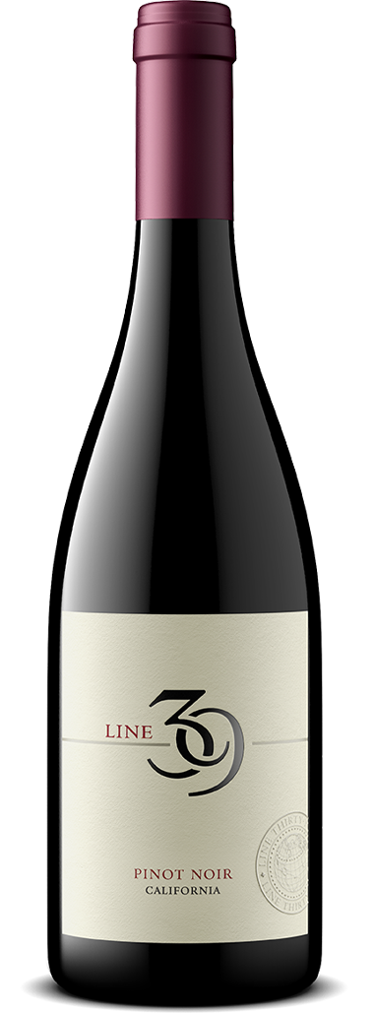

Current Retail Data Flow
Distribution
Channels
Store
Who?
What? Where? When?
Data
Barrier
??

Slide 3


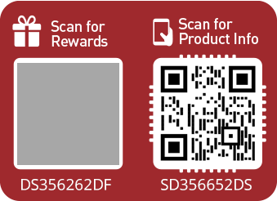

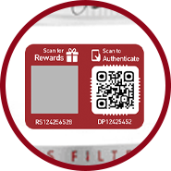

With NeuroTags
Store
Customer Type: High Value
Lexi Lee
lexi…@gmail.com
(415)-342-XXXX
From East G Ave, SFO
24th purchase
@ 9pm on 24th Dec 21
Two way instant connection
Marketing
AND..

Slide 4

Expected RoI
Based on aggregated results from our existing clients*
Items in the Market | Projected Signups | Projected Sales Impact
1M / yr | 15K - 45K / yr | 3 to 18% / yr
5M / yr | 100K - 400K /yr | 8 to 35% / yr
*Number of factors are at play, such as scratch-off tags, placement on the packaging, item’s price, promotions and marketing programs.

Slide 5
How?

Slide 6
Create a Unique Identity for each Item
Serialized Neuro Codes

Slide 7



Pre-Purchase - Engage Consumers at Point-of-Purchase
(no app needed)
Customer Assurance
Authenticate
Influences shoppers at their point of decision with your narrative
Product Photos/Videos
Right message, right moment!
User Rating and
Reviews
Lets your best marketing ads be seen when it matters the most
Product Story
Use videos and instagram to
engage users
Coupon Codes
You make your real estate on product packaging virtually infinite
Social Sharing
Notes:
Can we get the new graphic on this slide instead of what is above

Slide 8

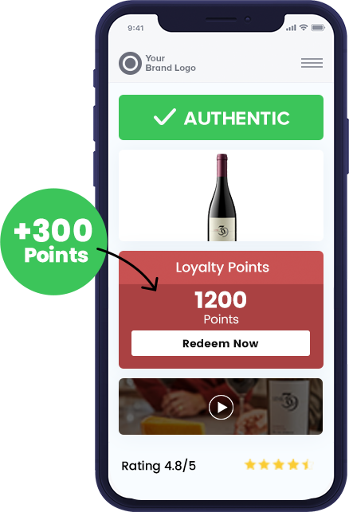
Post-Purchase - Acquire and Grow Your Consumer Base
Acquire and Monetize Consumers Thru Incremental Sales
Frictionless, App-free, Fully Integrated
Platform
Gamification & Loyalty
Warranty Registration
Consumer Contact Acquisition
Powerful, Actionable Instantaneous Data
Automated Marketing
Notes:
Can we get the new graphic on this slide instead of what is above

Slide 9
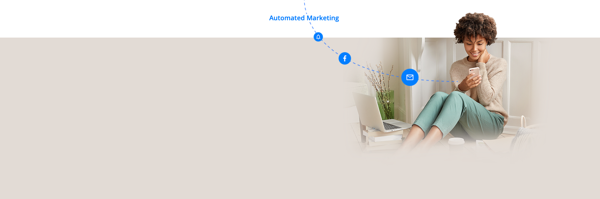
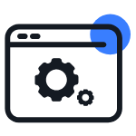



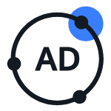
Engage via
NeuroTags Automated Marketing
Get 5 to 6 years of marketing tunings, optimizations and automations in just a few hours.
Specifically designed to increase the LTV of consumers for B2C businesses.
Automated Campaigns
Social Media
Managed Campaigns
Professional Consulting
Ads Network

Slide 10




NeuroTags Benefits
Signup and grow your consumer database
Track consumer’s purchase behavior to maximize your marketing efficiency
Exponentially increase repeat-sales through data
Protect your brand against counterfeiting

Slide 11



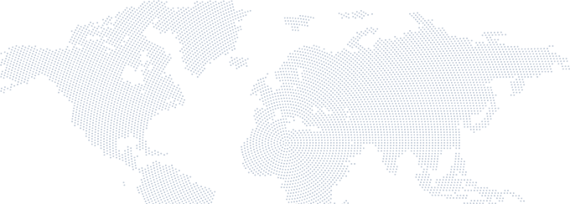
Thank You!
harvey@neurotags.com
+1 650-544-6554
www.neurotags.com
San Jose, US
Pune, India

